Slide 1
Final Project Presentation
Bollinger Band in R with Entry and Exit Signals at Reallocation Dates

Slide 2
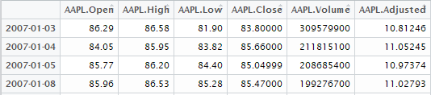
Input
Data source: Yahoo finance
Input format: the Close value from the getsymblos

Slide 3
Modling
Bollinger Bands:
Bollinger Bands is a tool invented by John Bollinger. The purpose of Bollinger Bands is to provide a relative definition of high and low. By definition, prices are high at the upper band and low at the lower band.
Bollinger consist of : an N-period,
an upper band at K times an N-period standard deviation above the moving average
an lower band at K times an N-period standard deviation below the moving average.

Slide 4
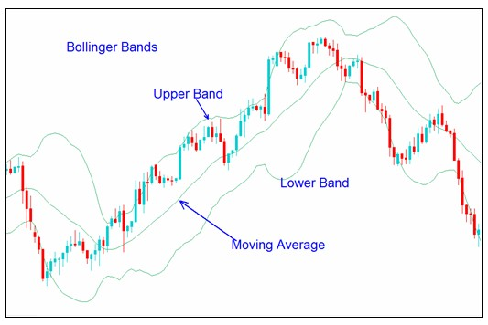
Bollinger Bands
Notes:
Entry Signal: when the Price of stock is above the upper Bollinger band.
Close Signal: when the Price of stock is below the lower Bollinger band.

Slide 5
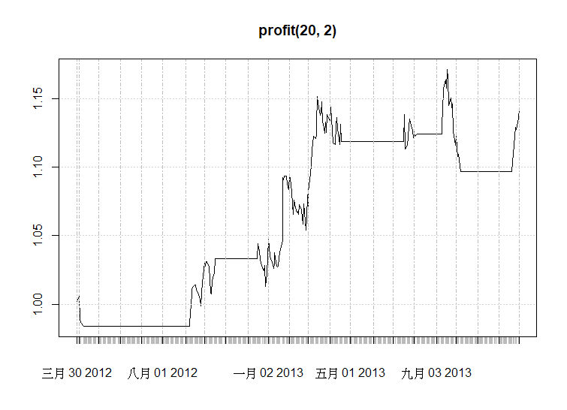
Output

Slide 6
Demo
https://github.com/JassHsu/1052DataScience/blob/master/FinalProject/finalproject.R
Challenge part: Reallocation dates.

